Slide 1
Contents
Logical Program Data Vector (LPDV or PDV),
Automatic SAS variables and how they are used,
Internals of DATA step processing,
Program compile time and execution time,
Error Processing in SAS
GPP
Arrays and loops
Introduction to Macro “Language”

Slide 2
LPDV

Slide 3
Compile Time
There is a distinct compile action and execution for each DATA and PROC step in a SAS program. Each step is compiled, then executed, independently and sequentially.
During the compilation of a DATA step,
Syntax scan
SAS source code translation to machine language
Definition of input and output files
Creation of tools:
Input buffer,
Logical Program Data Vector (LPDV),
Data set descriptor information
Determining variable attributes for output SAS data set
Capturing variables to be initialized to missing

Slide 4
Execution Time
All executable statements in the DATA step are executed once for each iteration
If input file contains raw data, then SAS reads a record into the input buffer. SAS then reads the values in the input buffer and assigns the values to the appropriate variables in the program data vector.
When the program reaches the end of the DATA step, three actions occur by default,
1. SAS writes the current observation from the program data vector to the data set.
2. The program loops back to the top of the DATA step.
3. Variables in the program data vector are reset to missing values.

Slide 5
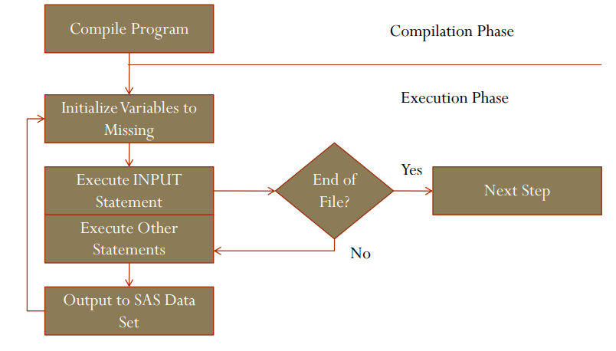

Slide 6
Example codes
SET and Merge
Merge with out BY
Multiple SET statements
The RETAIN statement does not retain
There is a snag in the lag
Predict the future event - “lead”
Interleave Back on itself
Avoid issues with combination of variables (Post transpose)

Slide 7
Data Conversion
Character to numeric, and numeric to character, conversions occur when:
incorrect argument types passed to function
comparisons of unlike type variables occur
performing type-specific operations (arithmetic) or concatenation (character)
SAS will perform default conversions where necessary and possible

Slide 8
Missing Values
Handling missing values with special missing. (.a - .z)
Help of formats
How function helps
Where function fails (overcome with help of other function)

Slide 9
Error Processing

Slide 10
Syntax errors occur when program statements do not conform to the rules of the SAS language. Here are some examples of syntax errors:
misspelled SAS keyword
unmatched quotation marks
missing a semicolon
invalid statement option
invalid data set option
Semantic errors occur when the form of the elements in a SAS statement is correct, but the elements are not valid for that usage. Semantic errors are detected at compile time and can cause SAS to enter syntax check mode.
specifying the wrong number of arguments for a function
using a numeric variable name where only a character variable is valid
using illegal references to an array

Slide 11
Execution-time errors are errors that occur when SAS executes a program that processes data values. Most execution-time errors produce warning messages or notes in the SAS log but allow the program to continue executing.
Common execution-time errors include the following:
illegal arguments to functions
illegal mathematical operations (for example, division by 0)
observations in the wrong order for BY-group processing
reference to a nonexistent member of an array (occurs when the array's subscript is out of range)
open and close errors on SAS data sets and other files in INFILE and FILE statements
INPUT statements that do not match the data lines (for example, an INPUT statement in which you list the wrong columns for a variable or fail to indicate that the variable is a character variable).

Slide 12
Good Programming Practices
Structure all programs as follows
Header
Initialization program
Other %include statements
Library / File References
SAS Options
Global/Local Macro Variables
Formats
Main Program
Alignment of code
Follow Case sensitivity
Use of mnemonics instead to special/logical characters

Slide 13
GPP (contd.)
Use the UPCASE and LOWCASE functions to ensure proper data comparisons.
Robust program code is essential for quality program construction.
Follow principles of “extendibility”, designing programs that can accommodate varying numbers of treatments, visits
Code defensively, keeping in mind potential changes in coding algorithms. Robust code continues to function correctly when confronted with unusual or unexpected data.
Anticipate a wide range of possible data values, including irregular data, when writing code. (No assumptions please) (eCRF, DTS need to be referred)
Safeguards such as below need to be included,
Check for missing values before performing calculations
Test programming code in small sections.
Put ERROR/WARNING statements for known issues until its resolved.

Slide 14
GPP (Contd.)
Advantages of Formats
Length as required
Easy to construct on constant/range values
Format creation by value and dataset

Slide 15
DO Loop: General Forms
Indexed DO loop:
DO variable = spec-1 <, …spec-n>
where spec-n is of the form: start <TO stop> <BY increment> <WHILE(expression) | UNTIL(expression)>
Conditional DO loops:
DO WHILE (condition);
DO UNTIL (condition);
Special:
DO OVER arrayname;

Slide 16
DATA _NULL_;
DO i = 1 TO 10;
PUT i=;
END;
RUN;
DATA _NULL_;
DO i = 1 TO 10;
PUT i=;
i = i + 2;
END;
RUN;
DATA _NULL_;
DO i=1 TO 20 BY 2;
PUT i=;
END;
RUN;
DATA test;
SET sashelp.class;
RUN;
Condition is checked at top of loop:
DO WHILE (condition);
<SAS statements>
END;
Condition is checked at bottom of loop:
DO UNTIL (condition);
<SAS statements>
END;
DATA _NULL_;
a=0; b=10; c=2;
DO i = A to B by C;
PUT i=;
a=22; b=33; c=44;
END;
RUN;
DATA _NULL_;
i = 0;
DO WHILE (i LT 3);
i = i + 1;
PUT i=;
END;
RUN;

Slide 17
No Hardcoding
A hardcode maybe obvious, for example:
if subjid='001001' then weight=75;
It may not be obvious
if yr > year(“&sysdate9”d) then yr = year(“&sysdate9”d);
If hardcodes are necessary then this should be clearly documented in the SAP/ programming specification document, also in the SAS code as a comment

Slide 18
Invalid and Duplicate Records
Invalid and duplicate should be checked when writing SAS codes
If multiple records are possible, check in the SAP/ Specification documents about handling rules
if n(hghtval) then do;
select(hghtunt);
when('CM') hghtsi=hghtval;
when('IN') hghtsi=hghtval*2.54;
otherwise put 'WAR' 'NING: Unexpected / unknown height unit: ' subjid= hghtval= hghtunt=;
end;
end;
if sum(first.subjid, last.subjid) < 2 then
put ‘WAR’ ‘NING: Unexpected multiple records ’ subjid= hgtval= hgtunt=;
If the variable being analyzed is a numeric, but the value is stored as a character:
It is best to do any comparisons using numeric values.
if ^missing(lborres) and lborres^='0';
If the lab value is ‘0.00’, then the code will not be sufficient exclude the lab value of 0.00

Slide 19
Some Do’s and Don’t
If a full date is expected for a particular variable, e.g. Date of Birth, Treatment Start Date, etc., then treat it as a full date and put out an exception to a log or LST file if a partial date is given.
Write code to deal with partial dates if partial dates are expected.
It is not good programming practice to write over data in database variables, even within a program where a temporary (work) dataset is being used. It makes it harder to track the flow of data
define the type and length of a new variable in a data step. This avoids the issue where SAS will assume a type and length of a newly created variable while the programmer may want another type and/or length

Slide 20
Some Macro Processing Tips
Pre-Macro Definition Setup
When developing the macro or other SAS code, clear the SAS log at the start of each development run
dm log 'clear' ;
Turn on the option to display macro compiler notes :
options mcompilenote= all /* Display macro compile information */ ;
Use %sysfunc or %qsysfunc to use SAS function within a macro

